Slide 1
ChannelFinder setup on vclx4
Jimmy You
Mar. 2022
https://www-bd.fnal.gov/controls/micro_p/channelfinder/channelfinder_setup.pptx

Slide 2
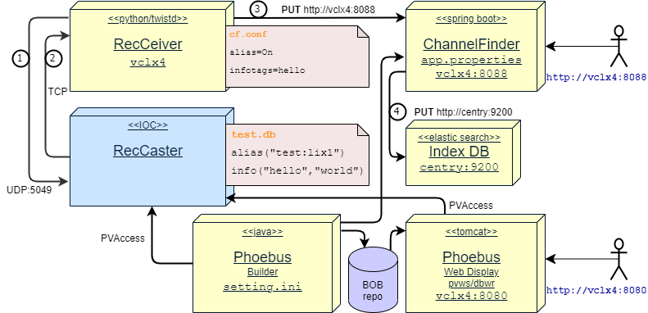
Deployment Diagram

Slide 3
Compoment: RecSync/RecCaster
https://github.com/ChannelFinder/recsync
EPICS module
Listen to UDP broadcast at port 5049
Forward PV and Field “alias” and “info” with TCP
st.cmd
## Register all support components
dbLoadDatabase("../../dbd/demo.dbd",0,0)
demo_registerRecordDeviceDriver(pdbbase)
var(reccastTimeout, 5.0)
var(reccastMaxHoldoff, 5.0)
epicsEnvSet("IOCNAME", "myioc")
epicsEnvSet("ENGINEER", "myself")
epicsEnvSet("LOCATION", "myplace")
test.db
record(longin, “test:li") {
alias(“test:lix1")
alias(“test:lix2")
info("test", "testing")
}

Slide 4
Compoment: RecSync/RecCeiver
https://github.com/ChannelFinder/recsync
Python with Twisted package and pyCFClient(https://github.com/ChannelFinder/pyCFClient)
twistd -n recceiver -f cf.conf
UDP broadcast to port 5049, with TCP callback info
Receive PV from IOC/RecCaster at the TCP port
Forward PV with pyCFClient API to ChannelFinder Web Service
Configuration:
cf.conf
addrlist = 255.255.255.255:5049
infotags = test hello
alias = on
channelfinderapi.conf
BaseURL=http://vclx4:8088/ChannelFinder

Slide 5
Compoment: ChannelFinder Web Service
https://github.com/ChannelFinder/ChannelFinderService
SpringBoot/Tomcat
Receive PV from RecCeiver via HTTP REST API
Use ElasticSearch Index DB
Three indices: mapping_definitions.sh
channelfinder/cf_channel
properties/cf_property
tags/cf_tag
Use embedded LDAP for authentication, configured in cf.ldif
Configuration: app.properties; cf.ldif
server.http.port=8088
logging.file=${java.io.tmpdir}/channelfinder.log
elasticsearch.network.host: centry.fnal.gov
elasticsearch.http.port: 9200
Run
nohup java --add-exports=java.naming/com.sun.jndi.ldap=ALL-UNNAMED
-Dspring.config.location=file:./target/classes/app.properties
-jar target/ChannelFinder-4.0.0.jar > /dev/null 2>&1 &

Slide 6
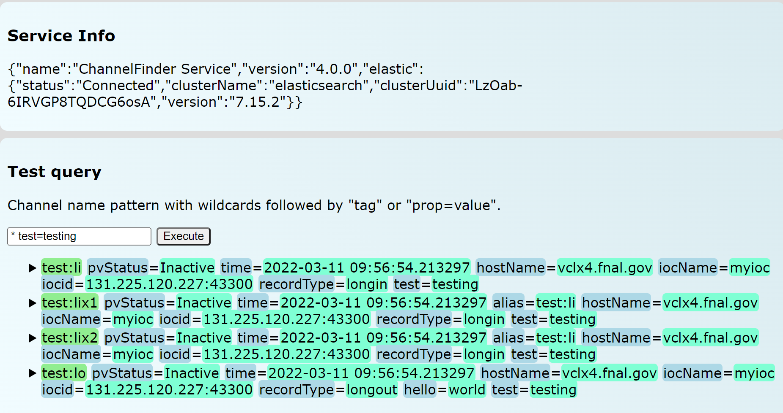
Compoment: ChannelFinder Web Service
Human interfaces
curl http://vclx4:8088/ChannelFinder/resources/channels?test=testing
http://vclx4:8088/
Phoebus Channel View
q: * test=testing
q: FNAL*DEW*

Slide 7
Phoebus display builder and web runtime
Display Builder
https://github.com/ControlSystemStudio/phoebus
Java based GUI tool to build control interface
Run: phoebus.sh
Configuration: settings.ini
org.phoebus.channelfinder/serviceURL=http://vclx4:8088/ChannelFinder
BOB repo: vclx4:/usr/local/epics/Config/CSS/PIP2TS/HB650
Web Runtime
https://github.com/ornl-epics/dbwr
https://github.com/ornl-epics/pvws
Tomcat with dbwr.war and pvws.war
Run: ~/apache-tomcat-9.0.58/bin/startup.sh
Configuration: bin/setenv.sh
export EPICS_CA_ADDR_LIST=131.225.120.227:6722
export PV_WRITE_SUPPORT=true
http://vclx4:8080/dbwr/view.jsp?display=http://vclx4:8080/PIP2TS/HB650/HB650cryostat.bob
BOB update/sync:
cp –rp /usr/local/epics/Config/CSS/PIP2TS ~/apache-tomcat-9.0.58/webapps/ROOT

Slide 8
Debug/Howto/Troubleshooting/log
RecSync/Reccaster/RecCeiver/demoIOC
code "fix“: __init__.py: remove reactor, pollreactor.install()
Enable debug: cf.conf: loglevel=DEBUG
debug with alternative port(5049 -> 5050): update announce.py and cf.conf and caster.h
python setup.jy install
ChannelFinder Web Runtime (app.properties)
logging.file=${java.io.tmpdir}/channelfinder.log
logging.level.org.elasticsearch.client.RestClient=ERROR
logging.level.gov.bnl.channelfinder.ChannelManager.audit=WARN
server.http.port=8088
Test
curl --basic -u x:x -H 'Content-Type: application/json' -X PUT -d '{"name":"foo", "owner":“x"}’ http://vclx4:8088/ChannelFinder/resources/tags/foo
curl http://vclx4:8088/ChannelFinder/resources/tags/foo
Copy file:
pscp -r -p -load via_nc_proxy pvws.war youj@clx28:
TCP tunneling
plink -N -T -no-antispoof -L 8088:vclx4.fnal.gov:8088 youj@outland.fnal.gov
Install python package on vclx4, via outback
ssh -D:1080 outback
proxychains pip3 install twisted

